Slide 1
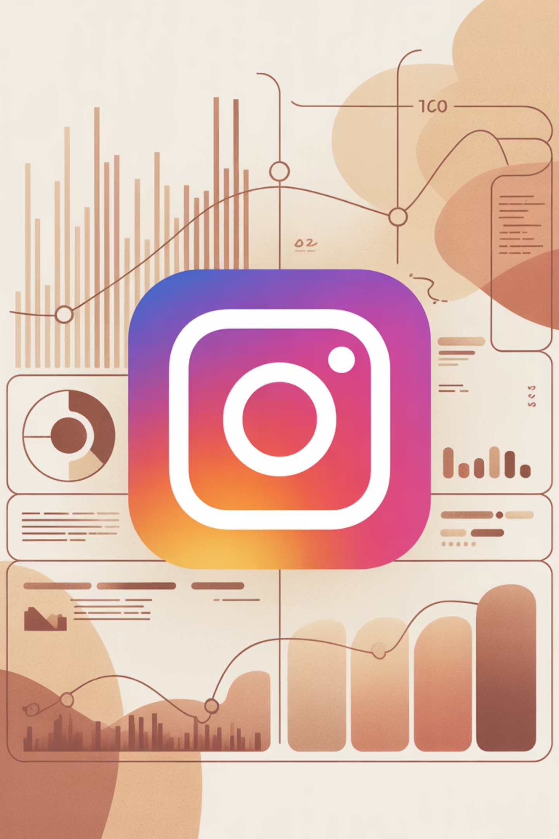
Instagram Business Analytics Report
Evaluating content effectiveness, engagement patterns, and growth drivers for strategic decision-making.

Slide 2

Project Overview & Dataset
Project Goal
Key Metrics
Analyze Instagram performance data from 29,999 posts to understand content effectiveness and engagement.
Likes, Comments, Shares, Saves
Reach, Impressions
Engagement Rate, Followers Gained

Slide 3

Exploratory Data Analysis (EDA)
01
Data Preparation
Loaded dataset using pandas, checked summary statistics, and handled null values (none found).
02
Column Standardization
Created "Total Engagement" by summing likes, comments, shares, and saves.
03
Feature Engineering
Generated virality, saves, and reach rates. Extracted post day, month, and hour.
04
Database Integration
Loaded cleaned DataFrame into PostgreSQL for advanced SQL analysis.

Slide 4

SQL Data Analysis: Key Questions
Traffic Source
Top Posts
Engagement Efficiency
Best Day to Post
Performance Over Time
Structured analysis in PostgreSQL answered critical questions about content performance and audience engagement.

Slide 5
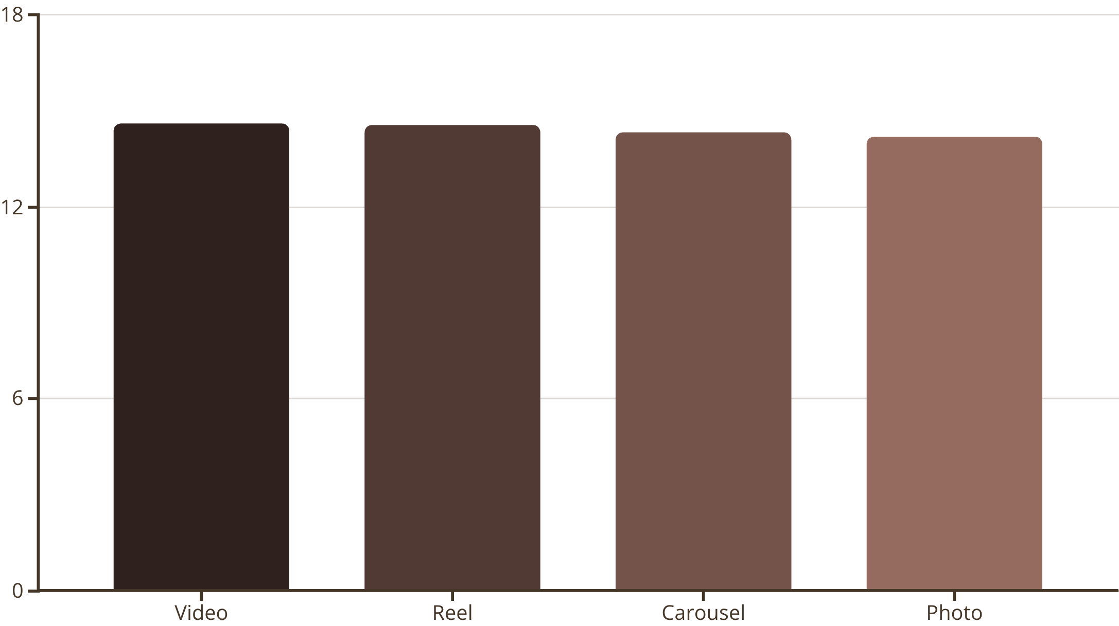
Engagement Efficiency by Media Type
Video content shows the highest average engagement rate, closely followed by Reels. This indicates a preference for dynamic, short-form content among the audience.
Photos and Carousels, while still engaging, perform slightly lower, suggesting a need to optimize static content strategies.

Slide 6

Optimal Posting Times & Organic Reach
Best Day to Post
Analysis identified specific days of the week that yield higher engagement and reach, guiding content scheduling.
Organic Virality
Determined which media types spread more organically, informing content creation for maximum natural reach.

Slide 7
Traffic Source Insights
Profile
External
1,012,731 Average Reach
999,816 Average Reach
Hashtags
Home Feed
997,386 Average Reach
995,130 Average Reach
Reels Feed
Explore
994,480 Average Reach
979,535 Average Reach
Profile and External sources drive the highest average reach, emphasizing the importance of direct navigation and external promotions.

Slide 8






Follower Growth by Content Category
Music
Lifestyle
Beauty
Photography
512 Followers Gained
508 Followers Gained
505 Followers Gained
503 Followers Gained
Food
Travel
503 Followers Gained
503 Followers Gained
Music, Lifestyle, and Beauty categories consistently lead in follower acquisition, highlighting their appeal to the target audience.

Slide 9

Key Business Insights
Reels Outperform
Short-form video content drives higher engagement than photos and traditional videos.
Discoverability
Hashtag and Reels feeds are crucial for expanding reach and audience discovery.
Growth Categories
Entertainment and lifestyle content categories are key drivers for follower growth.
Engagement-Follower Link
Higher engagement rates directly correlate with increased follower gains, reinforcing strategy.

Slide 10

Strategic Recommendations
Content Strategy
Optimization & KPIs
Prioritize Reels for marketing campaigns.
Invest in high-performing content categories.
Focus on shuffling between videos and reels.
Optimize hashtag strategy for organic reach.
Track engagement rate as a core KPI.
Upload beauty content on Wednesdays.

